Slide 1

Fake and Real News Detection
Presenting by Jeevan Raj

Slide 2

Survey Results
Research shows that 1 in 2 Indians recives fake news via Whatsapp and Facebook etc
As per the survey of Social Matters and Institute of Governance Policies and Politics
Research and Survey
So Why is Identifying Fake News Important ?
How many of you verify each and every piece of news you read before believing it?
If we don't Identify the news is fake or real Then their may be higher chances of getting fooled
Now a days Social Media is used for news reading
Before in the past only professional used to collect the news and publish it, But now a days any one can collect and publish
Therefore the authenticity of the news is difficult to judge

Slide 3
Major Problems
The increasing number of Fraud website in the internet which increases the number of fake news data by day
People are profiting by clickbait's and publishing fake news on online, By clicking on a clickbait, users are let to a page that contains false information
More clicks contirbutes to more money for content publishers
Fake news influences people perceptions
The raise of Fake news has become a global problem that even major tech companies like Facebook and google are struggling to solve. It can be difficult to determine whether a text is factual without additional context and human judgement.

Slide 4

Type of Fake News
Visual Based Type
Linguistic Based Type
Visual based are mainly like photoshopped image and videos which are posted in social medias, It is completely based on visual type
Linguistic based are mainly the manipulation of text and string content. This issues is with Blogs, News, or Emails

Slide 5
Project Details
In this project we propose a Deep Learning model to identify whether a News article is fake or not based on its content, We used NLP to detect the fake news
There are several attempts to use artificial intelligence technologies specifically Machine / Deep Learning techniques and NLP to detect fake news and stop it from spreading
As Human beings we read a sentence and paragraph we can interpret the words with the whole document and understand the context, given today's volume of news, It can be possible to teach a computer how to read and understand the difference between real and fake news using NLP.

Slide 6

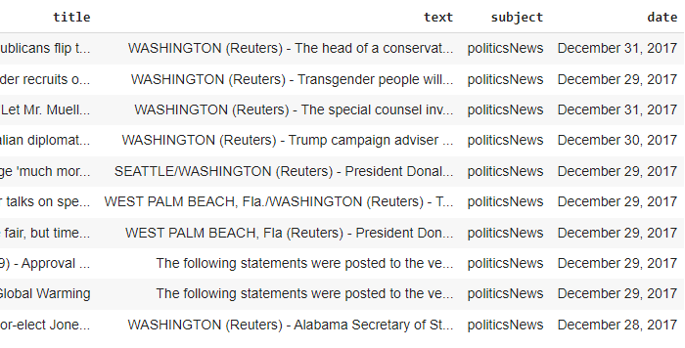


DATA SET INFO
Dataset is collected from kaggle website to train the and predict the news is Fake or Real
The Size of the dataset 44898 * 4
Real = 21417*4
Fake = 23481*4
Customer 5
Will split the data for traiining and testing set
70 % Training Data
30 % Testing Data

Slide 7

Requirement
Analysis
Data is collected from different data source.
Enhancing Performance
The performance of model is imporved by again refining the data and building the model again
Exploratory Data
Analysis
The data is being investigated to discover hidden patterns
example by using world cloud
Performance Testing
After creating the model the performance of model is being tested by using unknown data. The performance is analyzed by using accuracy, Confusion Matrix, Classification Report etc
Classifier
The dataset is trained and Model is created

Slide 8
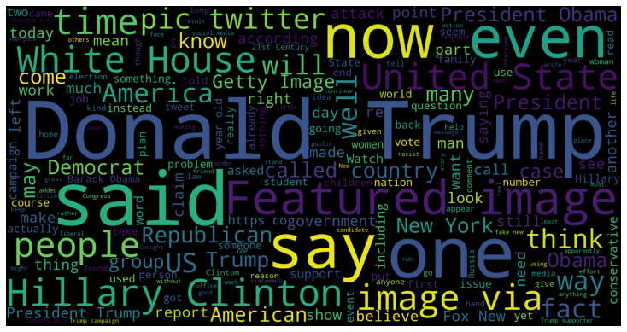
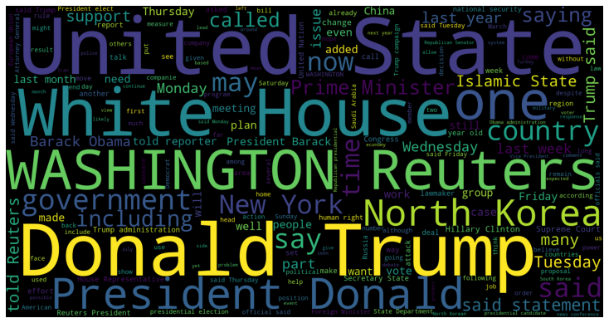
Word Cloud for both Fake and Real News
In fake news their will be no reference of Publications will be available
ex:- Washington Reuters
Most of the text contains reuters information such as Washington(Reuters)
Some text are tweets from Twitter
Few text do not contain any publication info we should treat accoringly

Slide 9
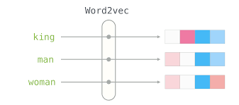
DATA PREPROCESSING
Steps Performed for data Preprocessing
Will join text and title to gether and make it as new text
Will remove the unwanted characters and make the data clean
Will use Word2Vec Vectorization
Word2Vec is one of the most popular technique to learn word embeddings using shallow neural network
Word Embedding is the most popular representation of document vocabulary, It is capable of capturing context of word in a document, semantic and syntatic similarity relation with other words

Slide 10
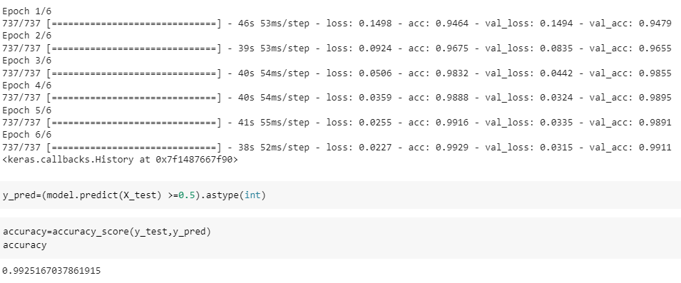
Model Building By Deep Learning using LSTM
By Using Long Short-Term Memory (LSTM), We got 99.29% in train, 99.11% in validation, 99.25% in Test

Slide 11
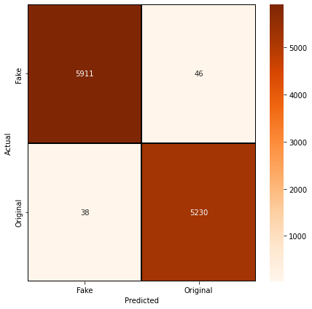
Performance of the Model
Confusion Matrix is used to define the Performance of the Model gives you the TP,FP,TN,FN
Out of total 5957 Fake News, Our Model is Predicted 5911 News Correctly and 46 News it is Predicted has original news
Out of total 5268 Original News, Our Model is Predicte 5230 News Correctly and 38 News it is Predicted has Fake News
The Overall accuracy of the Model is 99.25%

Slide 12




Personal INFO
Thank You
Name : Jeevan Raj
9141919300
jeevanrajraj1998@gmail.com
I look forward to working with you

